Slide 1
Indoor Navigation System
Author:
Shengxiong Wu
Haocheng Wang

Slide 2
Introduction
Project overview:
Goal:
Develop an indoor navigation system that can navigate inside the building
Motivation:
Save time.
Contribute to the York University Community.
Context:
Google Map can not navigate inside the building.
Navigation system in the Mall required BIM(Building Information Model)
This software can navigate inside the building in the campus.
This software is web-based.

Slide 3
Software Development Life Cycle
Requirements Analysis
Design
Development
Testing
Deployment
Maintenance

Slide 4
Requirements Analysis

Slide 5
Design&Development
Backend
Spring boot
SQLite
Frontend
HTML
CSS
JS

Slide 6
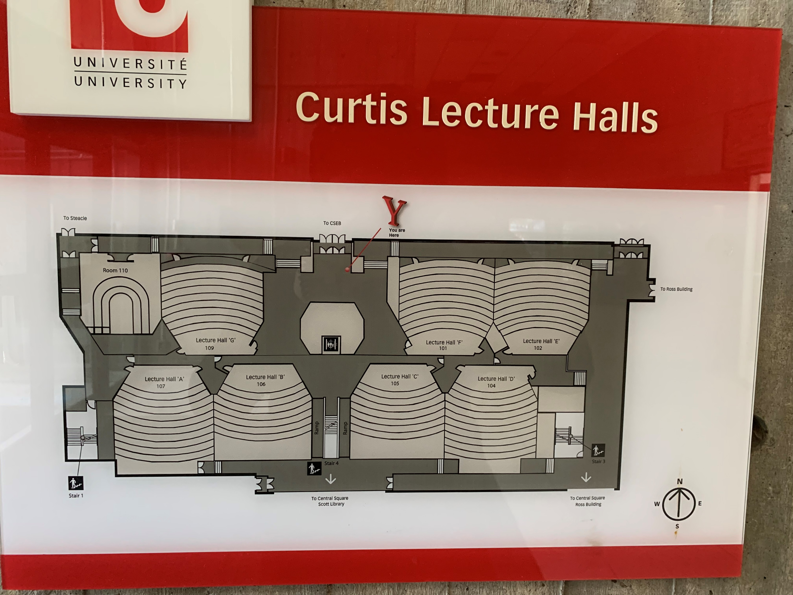
Floor Plan

Slide 7
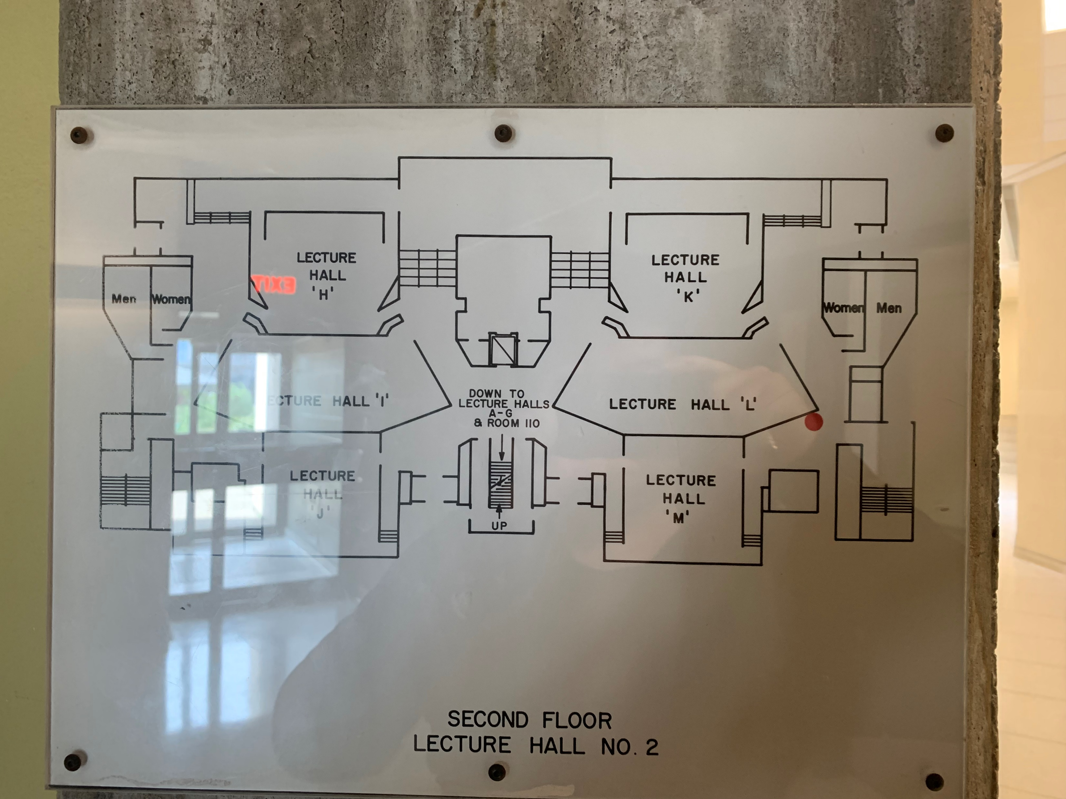

Slide 8
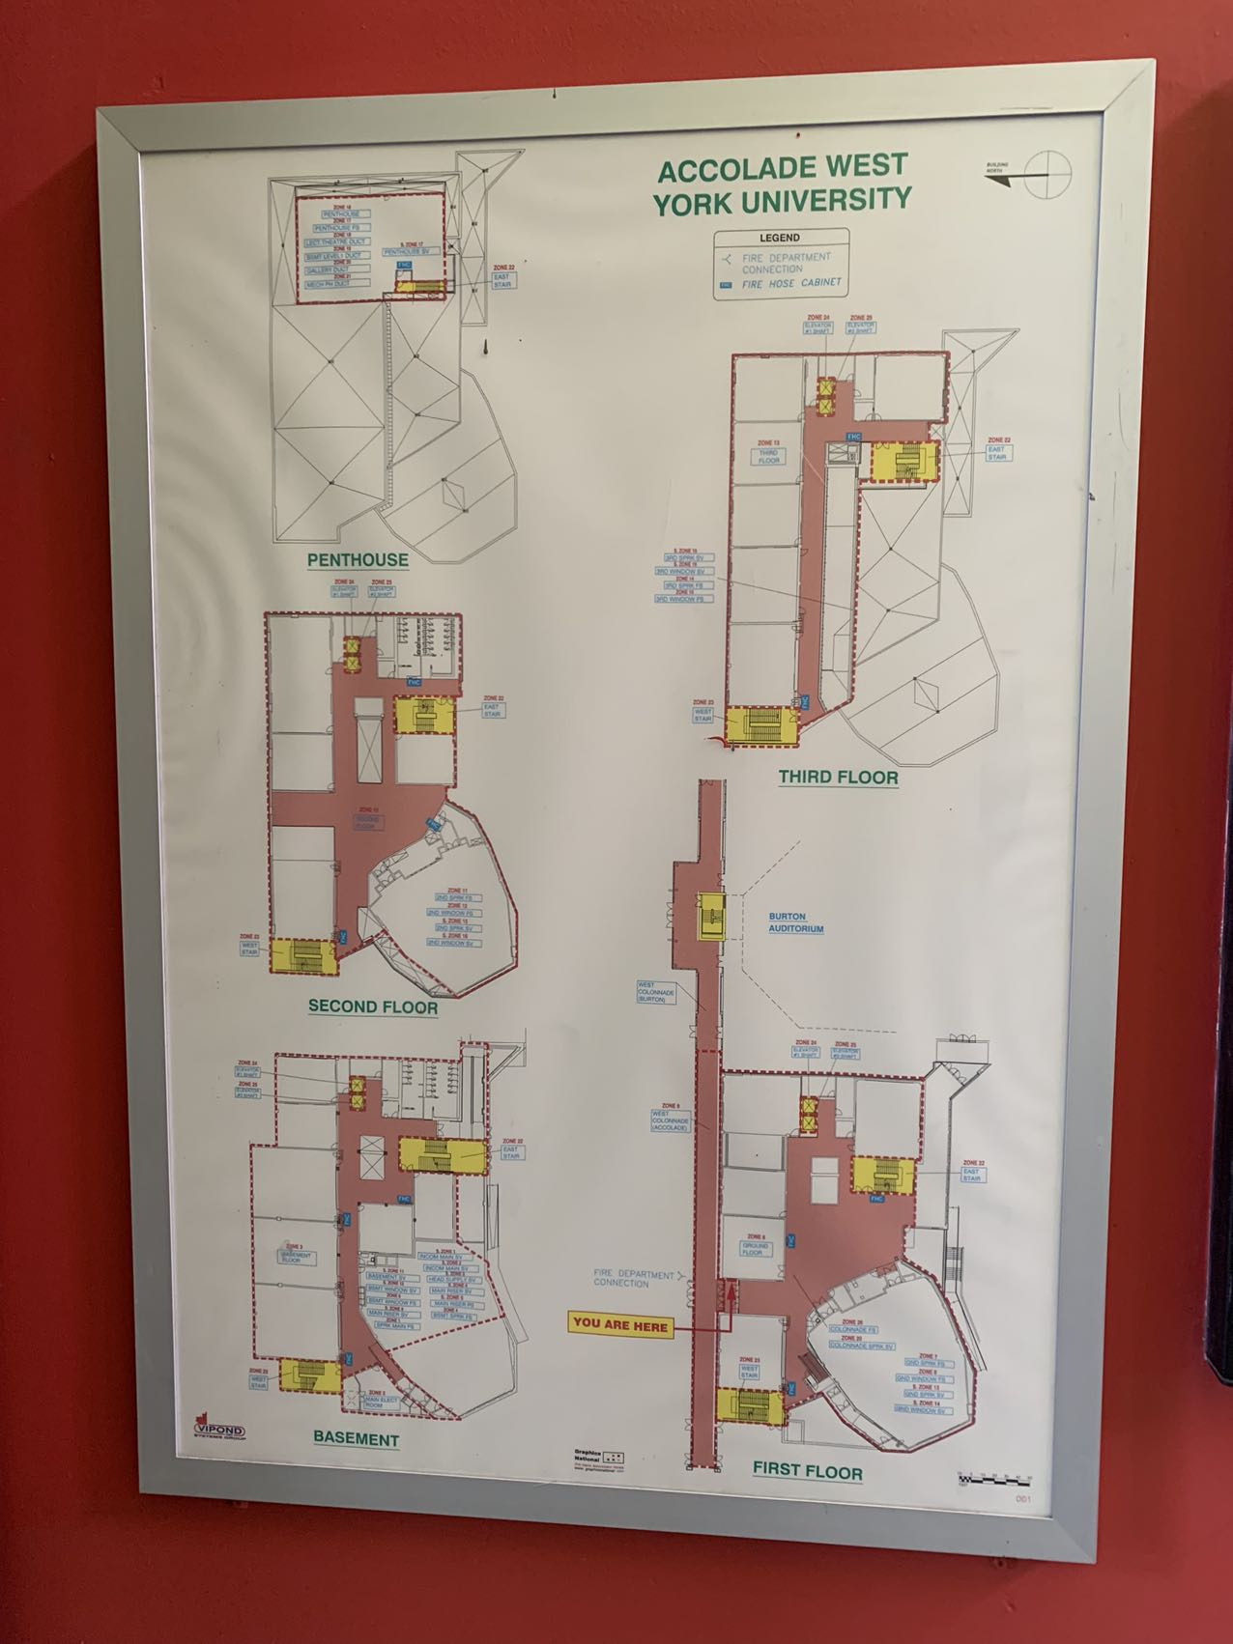
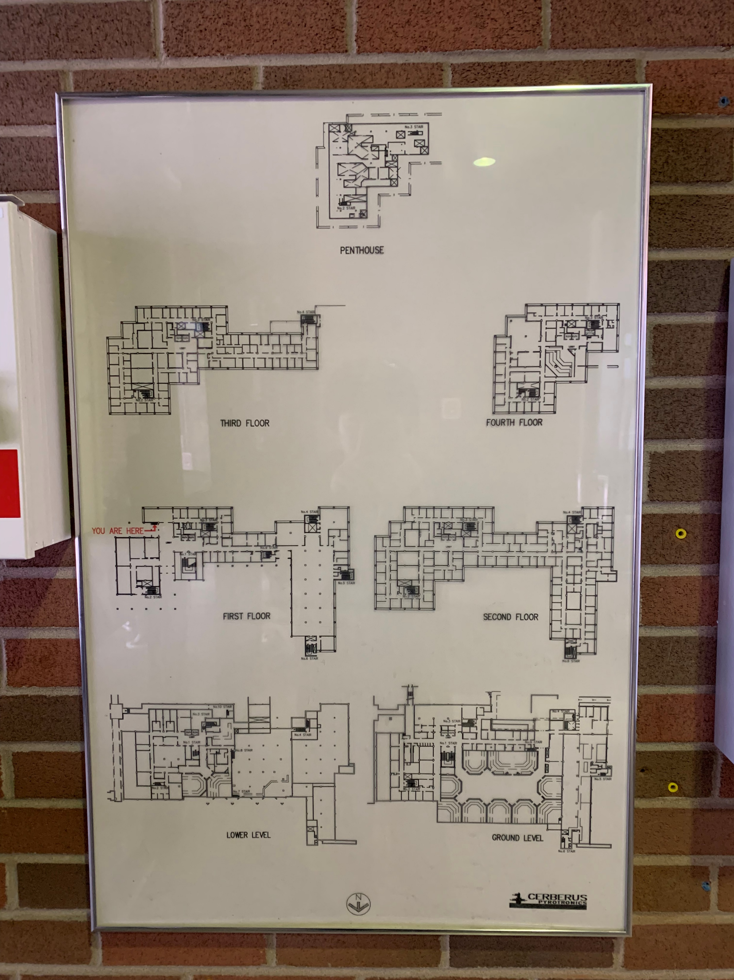

Slide 9
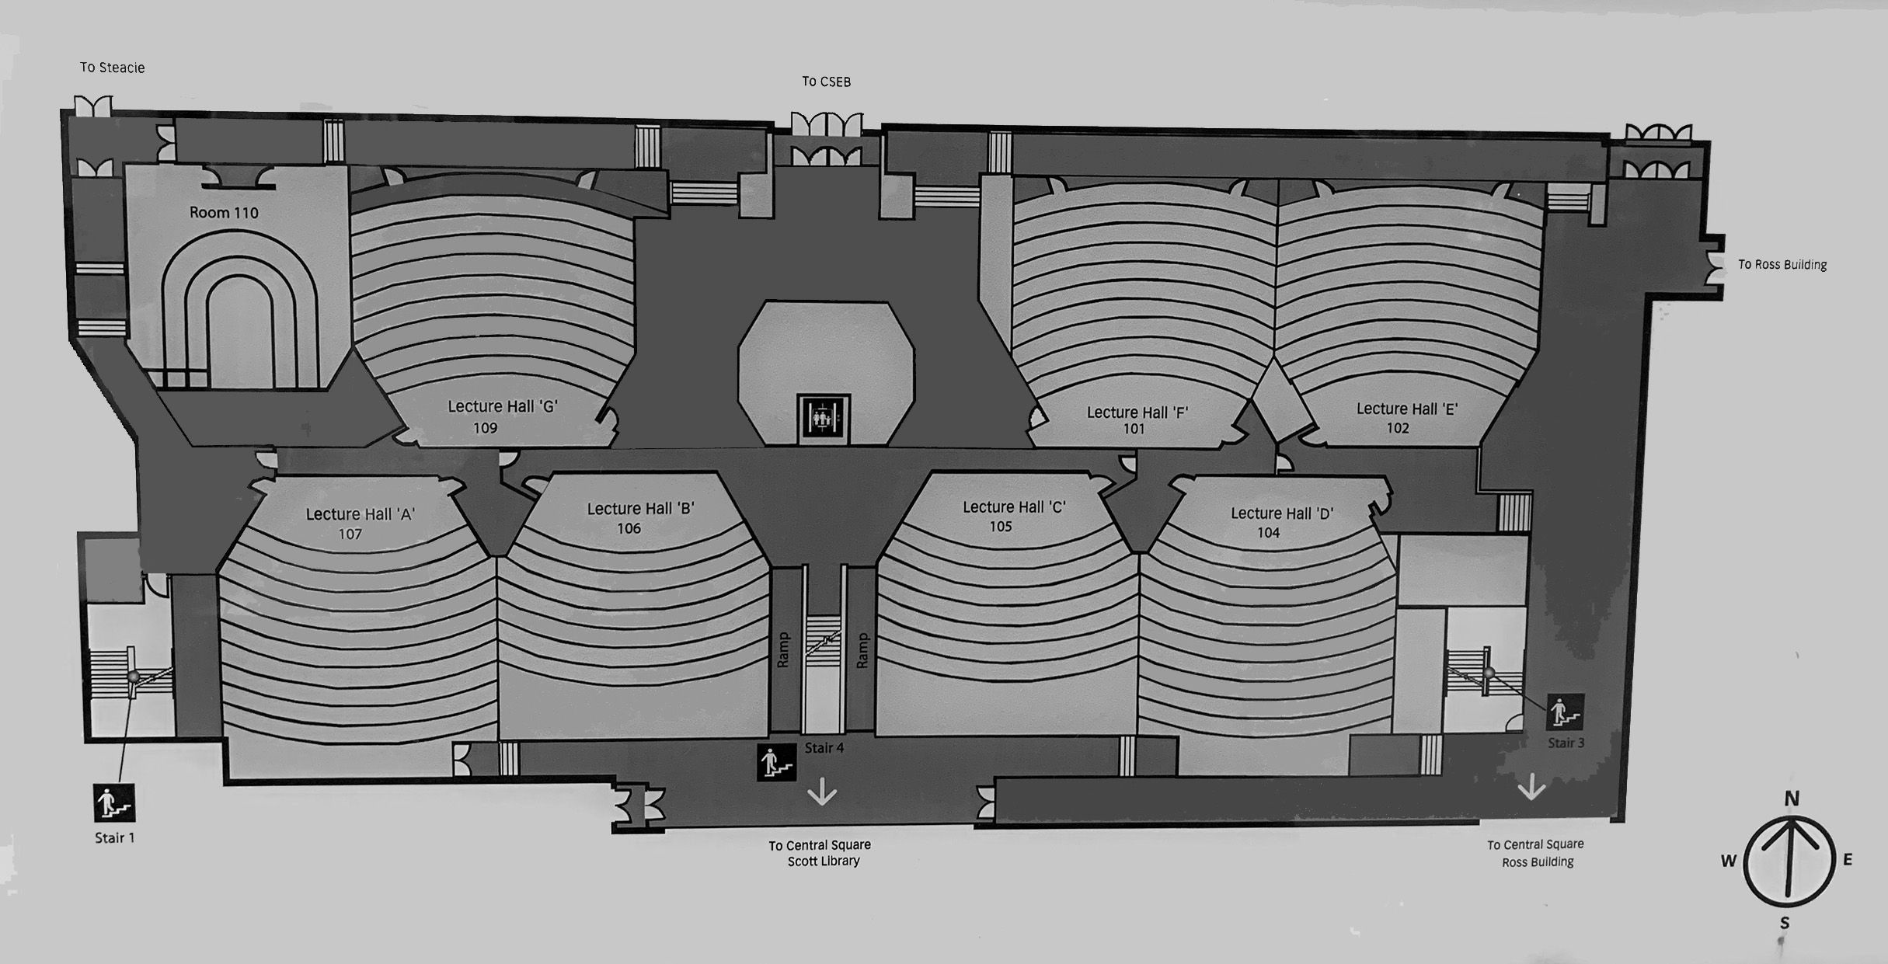
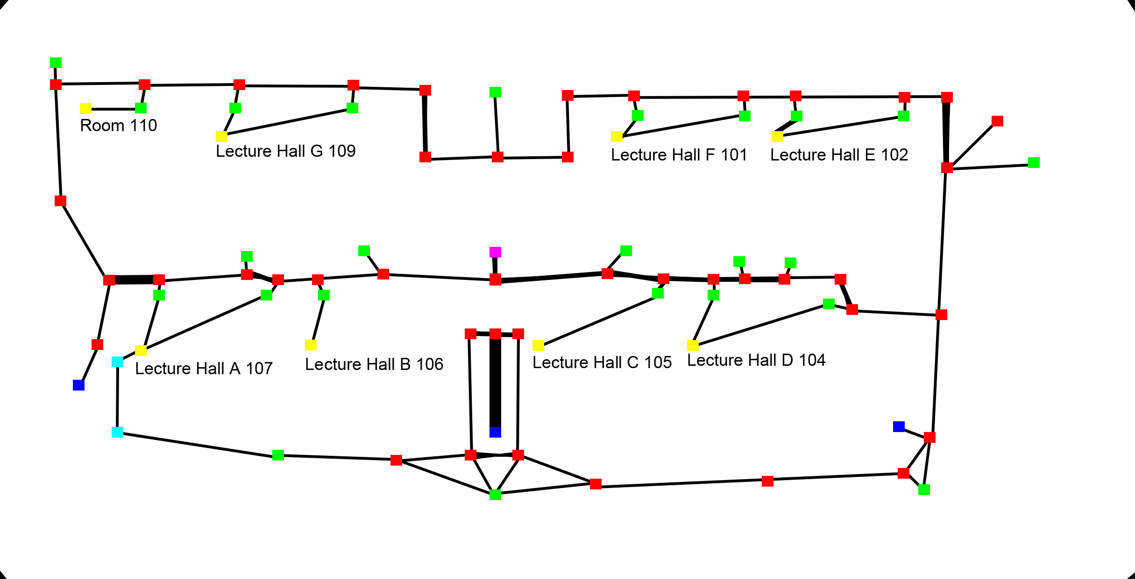
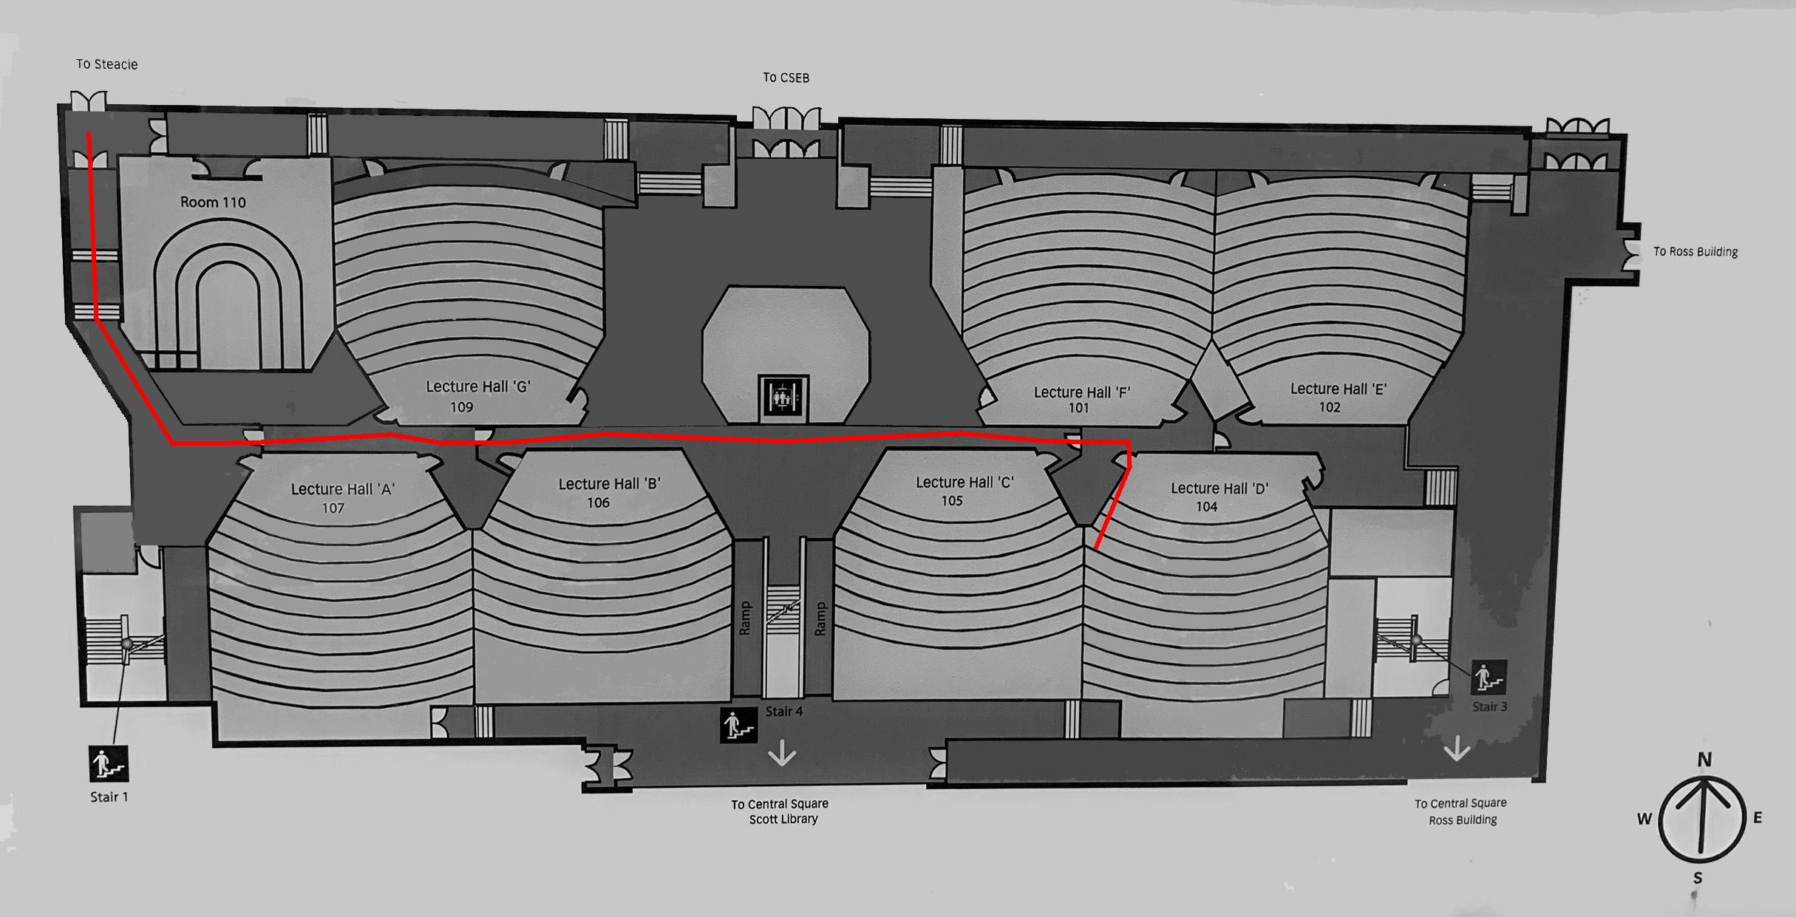
Proof of Concept

Slide 10
Help from Facilities Services/Campus Planning, Design & Construction
5 buildings

Slide 11
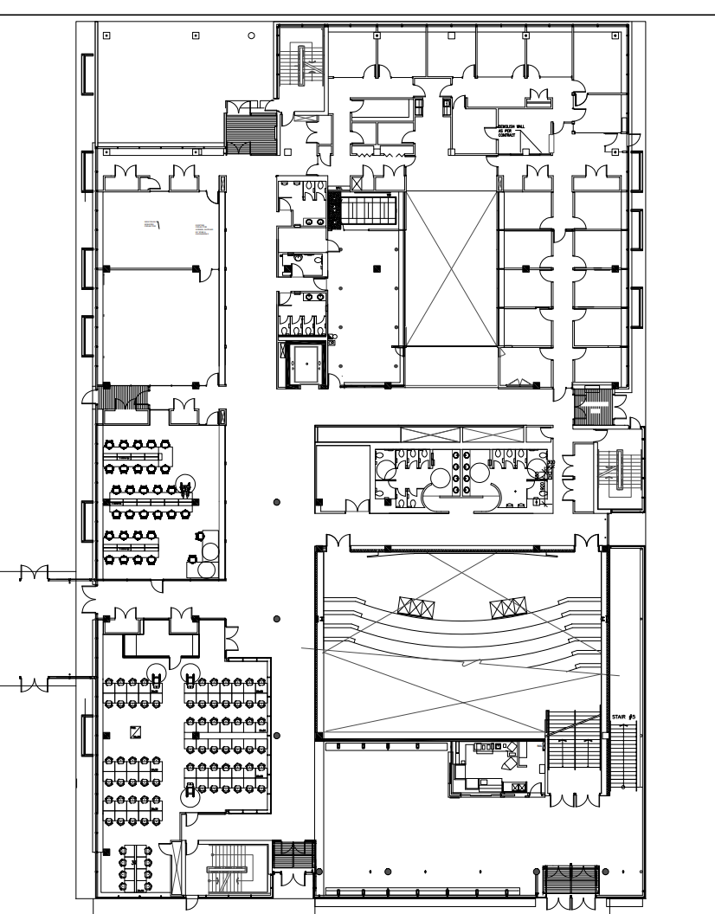
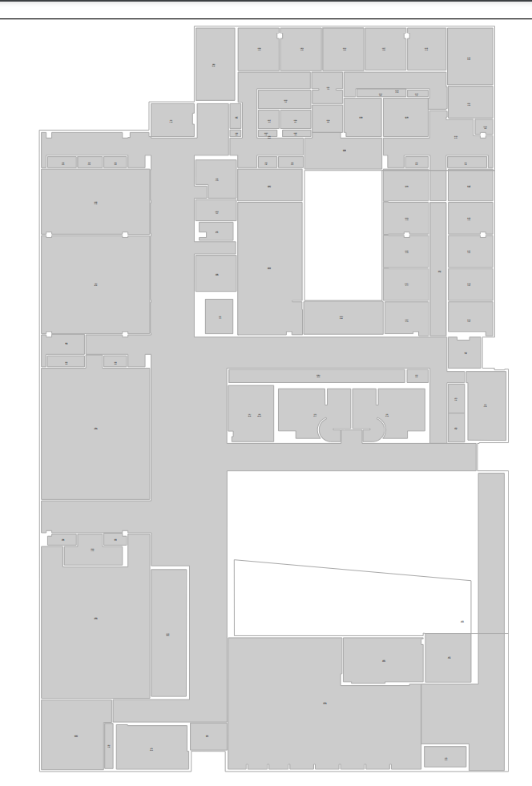
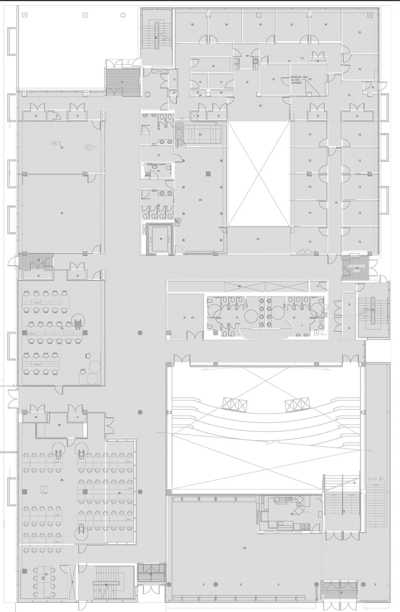
Digital Floor Plan

Slide 12

An Improved Notation Tool
Vector drawings delivered
Manual notating is still needed for now
Self-contained? Easy to use? Intuitive?

Slide 13
Requirement Analysis
Needs to ready-to-use
Small footprint
Internet connection shouldn’t be needed
Works locally with only the floorplan image, save to local then deploy to backend
Should be as intuitive as possible
Similar mode as the last generation solution
Point-and-click interaction
Performance shall be acceptable
As many as several hundred nodes on a single floor
Web-based solution with HTML + CSS + JS
HTML5 Canvas
Render anything controlled by JS
Not very easy to use!

Slide 14
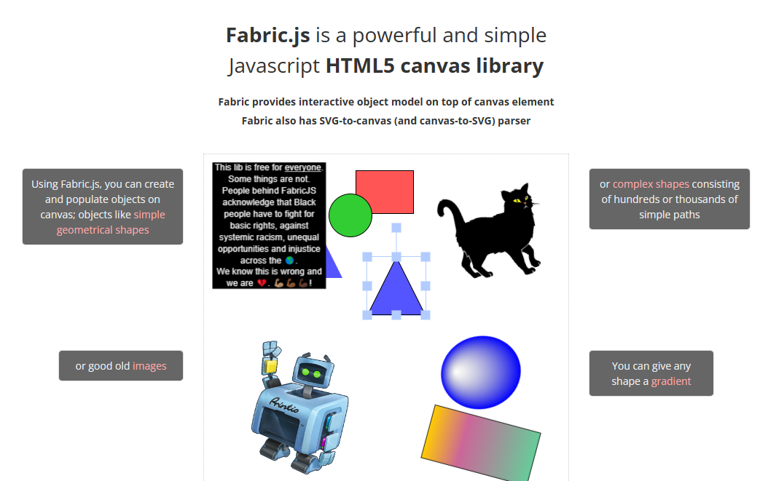
Enter Fabric.js

Slide 15
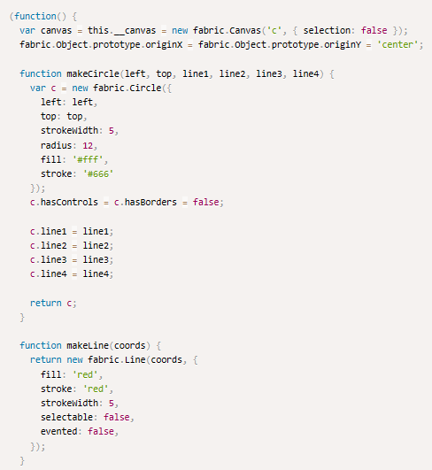
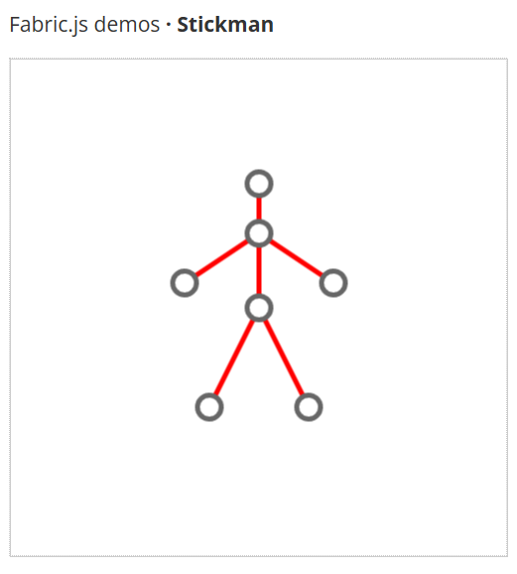
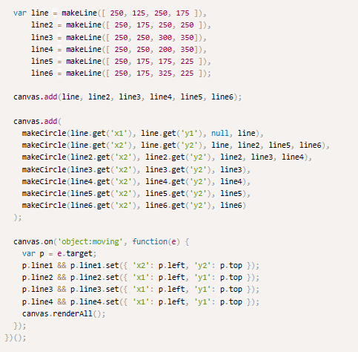
Looks similar…

Slide 16
Implementation

Slide 17
Deploy to Cloud
Will introduce by Haochen Wang later.

Slide 18
Testing

Slide 19
Project Results
Completed software development and implemented all functional requirements.
Completed software development and implemented all functional requirements.

Slide 20
Future work
Using Deep Learning or other CV techniques to automatically extract and connect the nodes from floor plan.
Extract and connect the nodes by using robot in the building.

